Slide 1
Suitable Camera and Rotation Navigation for People with Visual Impairment on Looking for Something Using Object Detection Technique
Masakazu Iwamura, Yoshihiko Inoue, Kazunori Minatani, Koichi Kise
Osaka Prefecture University
National Entrance Examination Center

Slide 2
Difficulty for people with visual impairment
People with visual impairment have a limited access to visual information
I want to drink tea, but which one is?
Person with visual impairment

Slide 3
Apps tell “what”
This is tea
Smartphone apps can tell “what it is”
Person with visual impairment

Slide 4
Apps that tell visual information
This paper focuses on this
Apps that can ask remote sighted people for help
Apps that use computer vision techniques
(Not available anymore)

Slide 5
Apps assume the object is in front
?
Person with visual impairment

Slide 6
Apps do not tell “where”
Smartphone apps do not tell “where it is”
Person with visual impairment

Slide 7
Category (i)
What
Unknown
Where
Known
Task
Obtaining the visual
information on the object
that the user photographs
Tools
and techniques
Current smartphone apps can be used

Slide 8
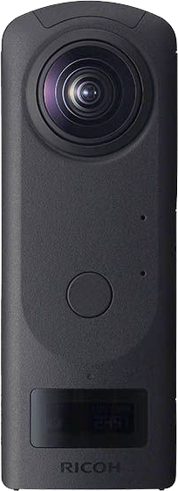
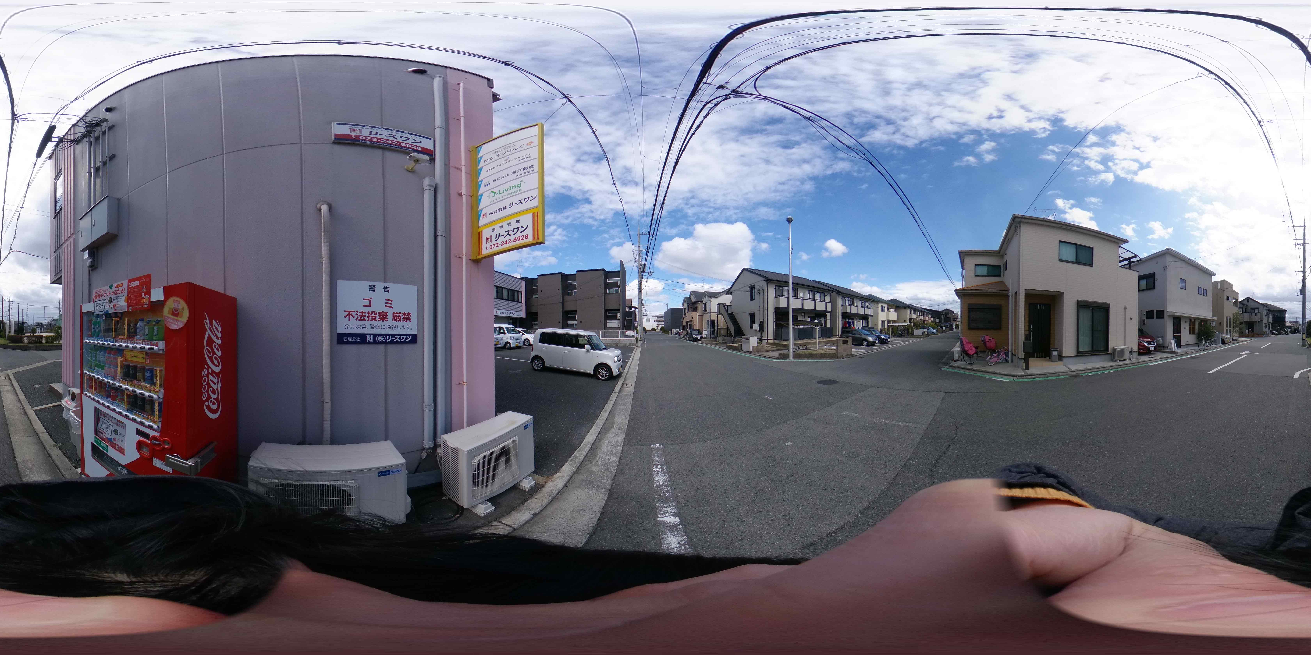
Category (i)
Category (ii)
What
Unknown
Known
Where
Known
Unknown
Task
Obtaining the visual
information on the object
that the user photographs
Looking for something
Tools
and techniques
Current smartphone apps can be used
Camera with a wide field of view
(e.g., omnidirectional camera) would be useful

Slide 9
Category (i)
Category (ii)
Category (iii)
What
Unknown
Known
Unknown
Where
Known
Unknown
Unknown
Task
Obtaining the visual
information on the object
that the user photographs
Looking for something
Finding something valuable and unexpected to the user
Tools
and techniques
Current smartphone apps can be used
Camera with a wide field of view
(e.g., omnidirectional camera) would be useful
The information provided
to the user should be selected

Slide 10
Category (i)
Category (ii)
Category (iii)
What
Unknown
Known
Unknown
Where
Known
Unknown
Unknown
Task
Obtaining the visual
information on the object
that the user photographs
Looking for something
Finding something valuable and unexpected to the user
Tools
and techniques
Current smartphone apps can be used
Camera with a wide field of view
(e.g., omnidirectional camera) would be useful
The information provided
to the user should be selected
This paper focuses on this

Slide 11
Overview of the research
In Looking for something:
We implement a computer-vision-based prototype system that guides the user to reach the target object
We investigate:
whether an omnidirectional camera is more suitable than a normal camera
We compare 5 rotation navigation methods including 3 novel voice navigation methods

Slide 12
Agenda
Introduction
Method
User study
Conclusion

Slide 13
Prototype system
Backpack
Step 1: Object detection
Step 2: Rotation navigation
Step 3: Forward navigation
System
Person with visual impairment
Looking for my backpack

Slide 14
Prototype system
Find a backpack
at 45 deg. on the right
Backpack
Step 1: Object detection
Step 2: Rotation navigation
Step 3: Forward navigation
System
Looking for my backpack

Slide 15
Prototype system
Backpack
Step 1: Object detection
Step 2: Rotation navigation
Step 3: Forward navigation
System

Slide 16
Prototype system
Backpack
Step 1: Object detection
Step 2: Rotation navigation
Step 3: Forward navigation
System

Slide 17
Existing Rotation Navigation
Ahmetovic+ (Percom 2019) examine 1 + 3 sound navigation methods in the context of turn-by-turn navigation
Ping
Intermittent sound (IS)
Amplitude modulation (AM)
Musical scale (MS)
Combined with Ping

Slide 18
Ping - Existing Rotation Navigation
Looking for my backpack
Ping
Intermittent sound (IS)
Amplitude modulation (AM)
Musical scale (MS)
Backpack
System
User with visual impairment
Ping

Slide 19
IS - Existing Rotation Navigation
Ping
Intermittent sound (IS)
Amplitude modulation (AM)
Musical scale (MS)
Pi
Interval
15Hz
Far
Angle
Close

Slide 20
AM - Existing Rotation Navigation
A 440 Hz sinusoid is modulated by a sub-audio sinusoid from 1 to 15 Hz
Ping
Intermittent sound (IS)
Amplitude modulation (AM)
Musical scale (MS)

Slide 21
MS - Existing Rotation Navigation
Do
Re
Mi
Fa
So
La
Si
Ping
Intermittent sound (IS)
Amplitude modulation (AM)
Musical scale (MS)
Do
The angle is subdivided into 8 circular sectors

Slide 22
Existing Rotation Navigation
Ahmetovic+ (Percom 2019) examine 1 + 3 sound navigation methods in the context of turn-by-turn navigation
IS and MS combined with Ping were the best

Slide 23
Proposed Rotation Navigation
3 voice navigation and 2 sound navigation methods
Left or Right (LR)
Angle (AG)
Clock Position (CP)
Intermittent Beep (IB)
Pitch (PT)
New
Voice navigation
Sound navigation

Slide 24
Left or Right (LR) - Proposed Rotation Navigation
Looking for my backpack
Left or Right (LR)
Angle (AG)
Clock Position (CP)
Intermittent Beep (IB)
Pitch (PT)
Backpack
System
Right, right, right, …
User with visual impairment
In front of you

Slide 25
Angle (AG) - Proposed Rotation Navigation
Left or Right (LR)
Angle (AG)
Clock Position (CP)
Intermittent Beep (IB)
Pitch (PT)
Backpack
System

Slide 26
Angle (AG) - Proposed Rotation Navigation
Left or Right (LR)
Angle (AG)
Clock Position (CP)
Intermittent Beep (IB)
Pitch (PT)
Backpack
System
60 degrees, right

Slide 27
Angle (AG) - Proposed Rotation Navigation
Left or Right (LR)
Angle (AG)
Clock Position (CP)
Intermittent Beep (IB)
Pitch (PT)
Backpack
System
15 degrees, right
In front of you

Slide 28
Clock Position (CP) - Proposed Rotation Navigation
Left or Right (LR)
Angle (AG)
Clock Position (CP)
Intermittent Beep (IB)
Pitch (PT)
2 o’clock
In front of you

Slide 29
Intermittent Beep (IB) - Proposed Rotation Navigation
Left or Right (LR)
Angle (AG)
Clock Position (CP)
Intermittent Beep (IB)
Pitch (PT)
Pi Pi Pi Pi … (Within 15 deg.)
Interval
Pi
Far
Angle
Close

Slide 30
Pitch (PT) - Proposed Rotation Navigation
Left or Right (LR)
Angle (AG)
Clock Position (CP)
Intermittent Beep (IB)
Pitch (PT)
Pi Pi Pi Pi … (Within 15 deg.)
High
Pitch
High pitch
Low pitch
Low
Far
Angle
Close

Slide 31
Agenda
Introduction
Method
User study
Conclusion

Slide 32
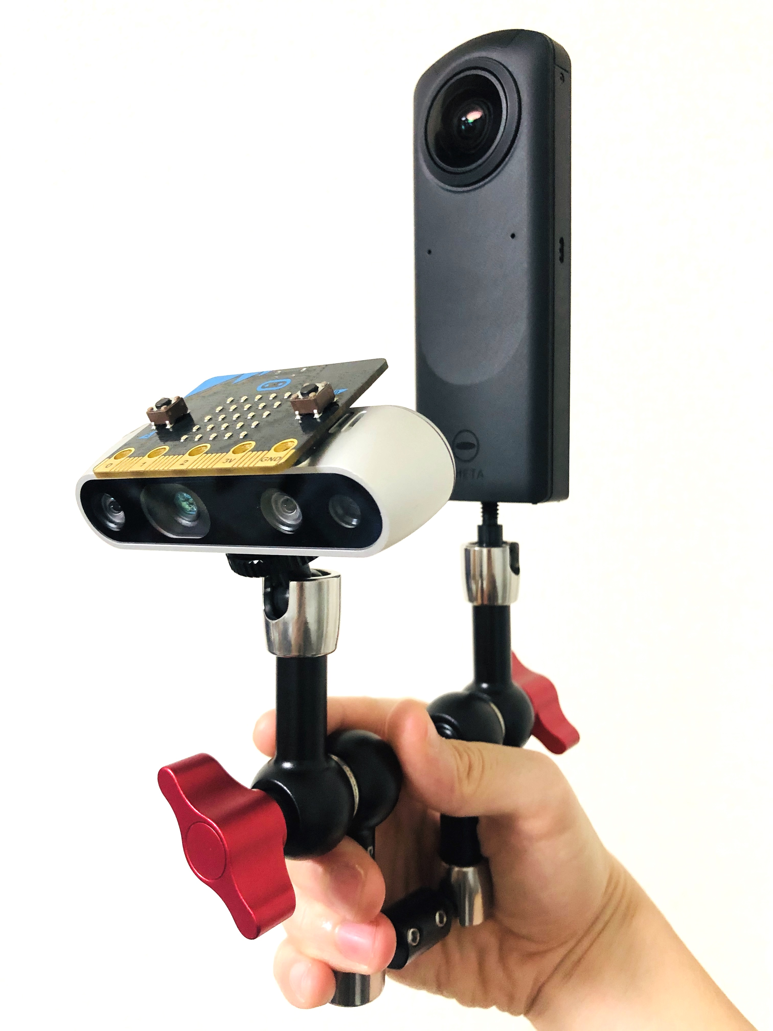
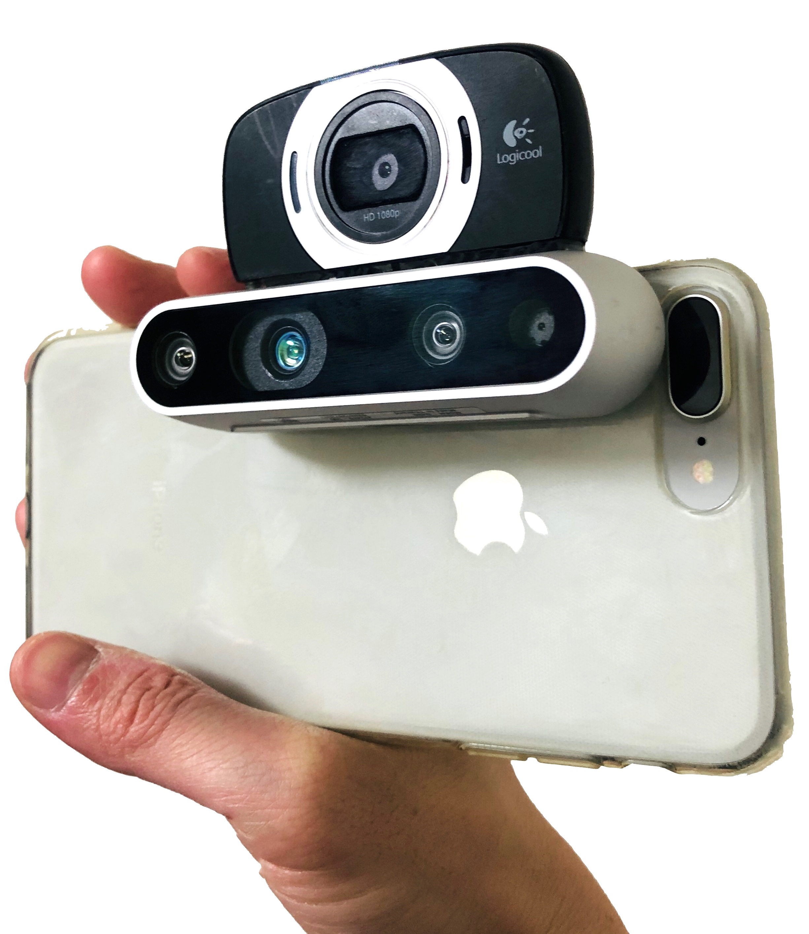
User study: Purposes
Comparison of 5 rotation navigation methods
Selection of camera
Electronic compass
Omnidirectional camera
Electronic compass
Web camera
Depth camera
Depth camera
Smartphone
(a) Omnidirectional camera
(b) Pseudo smartphone

Slide 33
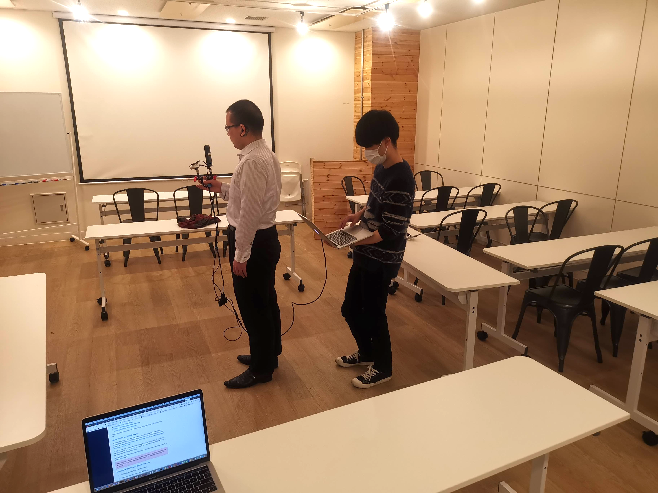
User study: Overview
Participants: 7 people with VI
Experiments
Comparison of 5 rotation navigation methods
Selection of camera
Survey (interview) for looking for something was performed before the experiments
Participant
Experimenter
Target

Slide 34
Survey on looking for something
Q4. How often do you encounter trouble in looking for something? → Mostly, more than once per week.
Q6. How do you look for something? → Mostly by groping. If available, ask a sighted person.
Q7. What item do you mostly look for? → Smartphone, earphones, cards, etc.
Q9. Where do you find lost stuff? → On a chair, table or floor. In the pocket of a jacket or bag.
For the rest, check out the paper

Slide 35
Experiment 1: Rotation navigation
 |  | 23 F | 27 M | 27 F | 48 M | 48 M | 27 M | 34 F | Average
Voice | Left or right (LR) | 4 | 2 | 3 | 2 | 1 | 4 | 2 | 2.6
 | Angle (AG) | 4 | 4 | 3 | 5 | 3 | 4 | 5 | 4.0
 | Clock position (CP) | 5 | 2 | 5 | 3 | 4 | 5 | 3 | 3.9
Sound | Intermittent Beep (IB) | 3 | 5 | 4 | 4 | 4 | 3 | 5 | 4.0
 | Pitch (PT) | 2 | 4 | 4 | 4 | 5 | 2 | 4 | 3.6

Slide 36
Experiment 1: Rotation navigation
 |  | 23 F | 27 M | 27 F | 48 M | 48 M | 27 M | 34 F | Average
Voice | Left or right (LR) | 4 | 2 | 3 | 2 | 1 | 4 | 2 | 2.6
 | Angle (AG) | 4 | 4 | 3 | 5 | 3 | 4 | 5 | 4.0
 | Clock position (CP) | 5 | 2 | 5 | 3 | 4 | 5 | 3 | 3.9
Sound | Intermittent Beep (IB) | 3 | 5 | 4 | 4 | 4 | 3 | 5 | 4.0
 | Pitch (PT) | 2 | 4 | 4 | 4 | 5 | 2 | 4 | 3.6
No one preferred LR because it does not tell anything about the rotation angle

Slide 37
Experiment 1: Rotation navigation
 |  | 23 F | 27 M | 27 F | 48 M | 48 M | 27 M | 34 F | Average
Voice | Left or right (LR) | 4 | 2 | 3 | 2 | 1 | 4 | 2 | 2.6
 | Angle (AG) | 4 | 4 | 3 | 5 | 3 | 4 | 5 | 4.0
 | Clock position (CP) | 5 | 2 | 5 | 3 | 4 | 5 | 3 | 3.9
Sound | Intermittent Beep (IB) | 3 | 5 | 4 | 4 | 4 | 3 | 5 | 4.0
 | Pitch (PT) | 2 | 4 | 4 | 4 | 5 | 2 | 4 | 3.6
Everybody has a different preference

Slide 38
Experiment 1: Reported related results
Reported related results
Ahmetovic+ (PerCom 2019): musical experience affects the users’ behavior
Ahmetovic+ (W4A 2019): expertise affects interaction preferences in navigation assistance

Slide 39
Experiment 1: A comment on rotation navigation
Participant B preferred to put the target, instead of himself, at the 12 o’clock position
(Target is at) 2 o’clock
(You’re at) 10 o’clock
Proposed way
Participant B’s preference

Slide 40
Experiment 2: Camera system
 | 23 F | 27 M | 27 F | 48 M | 48 M | 27 M | 34 F | Average
Omnidirectional camera | 4 | 4 | 4 | 5 | 5 | 3 | 5 | 4.2857
Pseudo smartphone | 3 | 2 | 5 | 3 | 3 | 1 | 2 | 2.7143
6 participants preferred omnidirectional camera

Slide 41
Experiment 2: Pros and cons of omnidirectional camera
Pros
I did not have to rotate to find the object
It told me the direction of the target object
It found the object earlier than the smartphone
Cons
It was heavy
Finding the bottle took time more than I expected
The device is not common
The “front” the system said was slightly different from my real front

Slide 42
Experiment 2: Pros and cons of pseudo smartphone
Pros
As I can use my smartphone, it is easy to introduce
Easy to hold
Cons
It was hard to capture the target object
I needed to adjust the angle
The system could not find the object unless it captures it, which frustrated me → I prefer to grope

Slide 43
Agenda
Introduction
Method
User study
Conclusion

Slide 44
Conclusion
We categorized the tasks of obtaining visual information into three
We proposed a prototype system for looking for something that used an omnidirectional camera and the use of voice in rotation navigation
A user study comprised of 7 people with visual impairment confirmed that
(1) an omnidirectional camera is preferred
(2) users have different preferences in rotation navigation

Slide 45
Future work
Personalization of the system
Finding “my” train pass
Preferred navigation way
Existence of the object >>> Direction >> Distance
Existence of the object is much more important than navigation
If it takes time to detect the object or fails in detection, the user thinks the object does not exist in the room

Slide 46
Suitable Camera and Rotation Navigation for People with Visual Impairment on Looking for Something Using Object Detection Technique
Masakazu Iwamura, Yoshihiko Inoue, Kazunori Minatani, Koichi Kise
Osaka Prefecture University
National Entrance Examination Center

