Slide 1
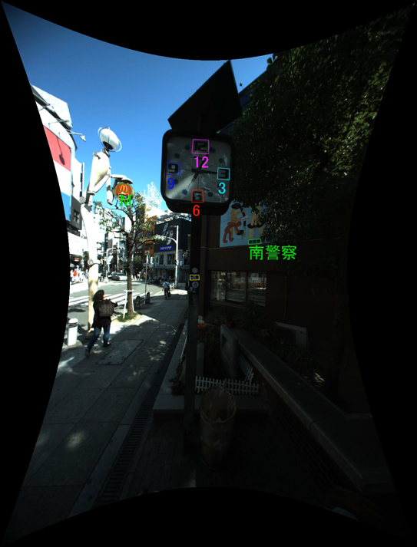

Downtown Osaka Scene Text Dataset
DOST Dataset
Masakazu Iwamura, Takahiro Matsuda
Naoyuki Morimoto, Hitomi Sato
Yuki Ikeda and Koichi Kise
Osaka Prefecture University

Slide 2
Agenda
Introduction
Unique Features of DOST Dataset
Construction of DOST Dataset
Known Issues
Evaluation
Conclusion

Slide 3
Agenda
Introduction
Unique Features of DOST Dataset
Construction of DOST Dataset
Known Issues
Evaluation
Conclusion

Slide 4
Recent Improvement of
Scene Text Recognition
Recent results are 80+% or even 90+%
This does not mean these methods can read
a wide variety of text in the real environment

Slide 5
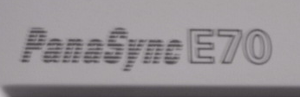
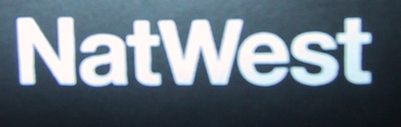
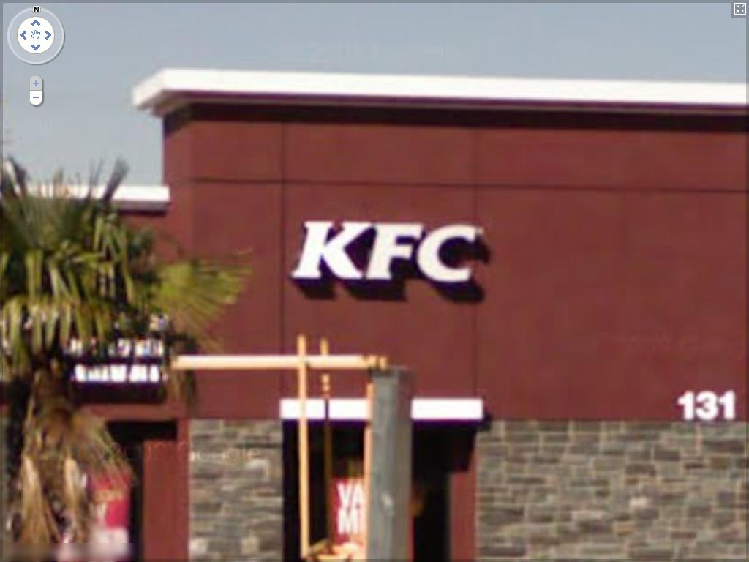
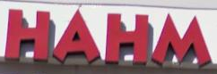
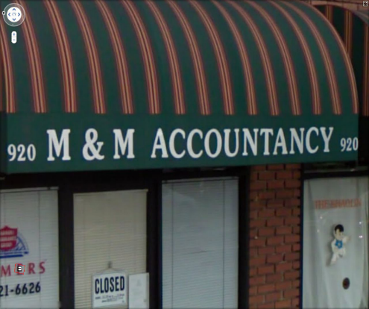
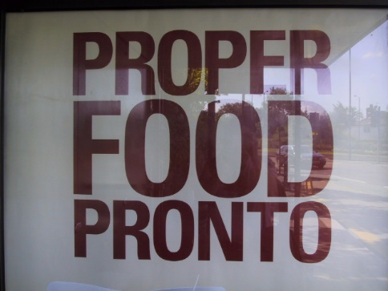


Text in Real Environment
“Scene Text in the Wild”
We mean
  Text captured without intention
  (as much as possible)
  Text not screened so as to be easily read
  (with regard to resolution, capture angle and so on)

Slide 6
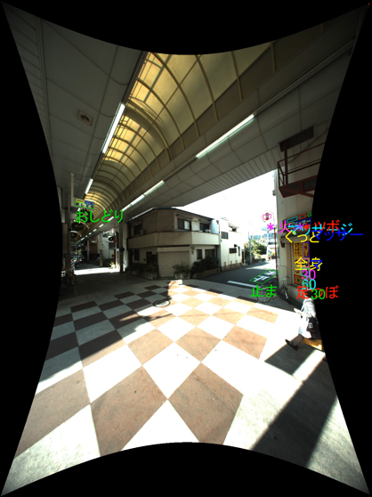
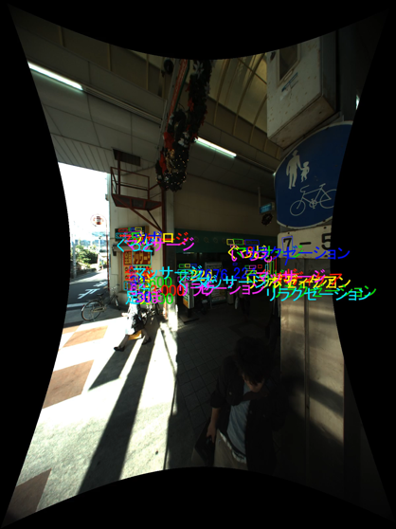
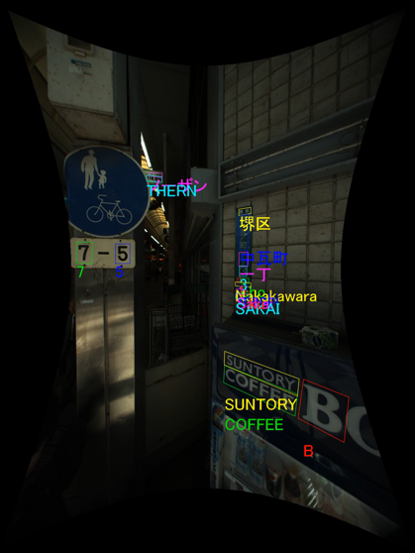
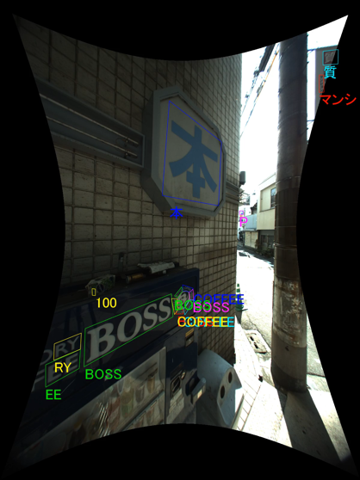
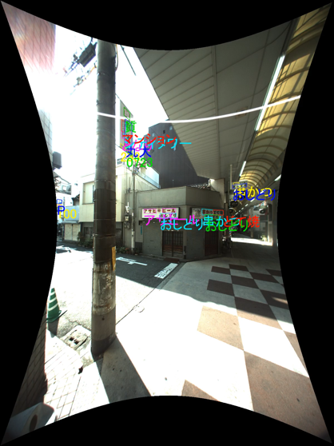
We present
DOST
Dataset

Slide 7
Agenda
Introduction
Unique Features of DOST Dataset
Construction of DOST Dataset
Known Issues
Evaluation
Conclusion

Slide 8
Unique Features of
DOST Dataset
Aim: evaluation of methods
in the real environment
  Not aiming at training classifiers
  like MJSynth and SynthText datasets
Completely not intentionally captured
  The most similar is ICDAR2015 Challenge 4 “incidental scene text” dataset captured with Google Glass
  DOST is even free from face direction

Slide 9



Unique Features of
DOST Dataset
Video dataset captured with omnidirectional camera
  ICDAR2013 & 2015 Challenge 3: single direction
  YouTube Video (YTV) Dataset: YouTube Videos
Contains multiple images of single word

Slide 10
Unique Features of
DOST Dataset
Large scale
  Contains largest number of word Images
    Excluding synthesized datasets
    (MJSynth and SynthText)
    Excluding dataset containing numbers only
    (Google Streetview House Number dataset)

Slide 11
No. of Images Contained in Existing Datasets
Image DB
Video DB
Almost
double

Slide 12
No. of Word Images Contained in Existing Datasets
Image DB
Video DB
Images were captured
in shopping streets
where a lot of texts exist
x4.6

Slide 13
No. of Word Sequences in Existing Video Datasets
x6.3

Slide 14
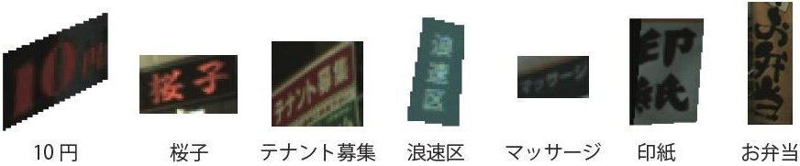

Unique Features of
DOST Dataset
Contains Japanese characters
  On the other hand, a lot of non-Japanese words are contained

Slide 15
No. of Ground Truthed Characters per Category
Japanese characters

Slide 16
No. of Ground Truthed Characters per Category
日 本 店 円 大 工 中 四 業 房 会 北
月 千 元 年 間 販 売 酒 家 取 台 止
あ い う え お か き く け こ
さ し す せ そ た ち つ て と
ア イ ウ エ オ カ キ ク ケ コ
サ シ ス セ ソ タ チ ツ テ ト
～ ！ ＃ ＆ （ ） ＊ ， - ． ／ ：
？ × ’ ↑ → ★ 、 。 々 〇 」 ・
Japanese characters

Slide 17
Unique Features of
DOST Dataset
Manually ground truthed
  Amazon Mechanical Turk is not usable
  Hiring students costed a lot!

Slide 18
Agenda
Introduction
Unique Features of DOST Dataset
Construction of DOST Dataset
Known Issues
Evaluation
Conclusion

Slide 19
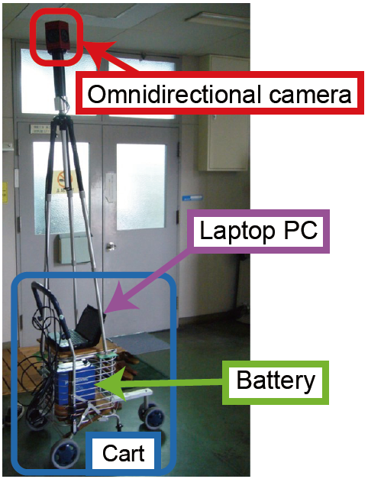
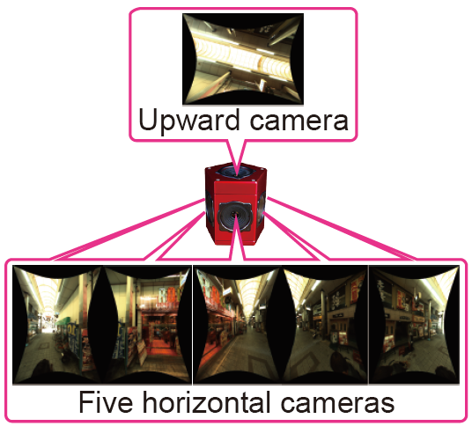
Construction of
DOST Dataset
Image capture
  Point Grey Research LadyBug 3
  1,200x1,600 pixels, 6.5 fps
Completed in 2012

Slide 20
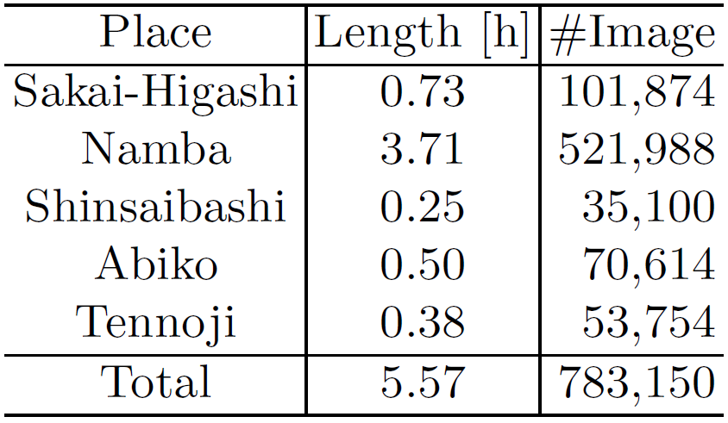
Place, time length, the number of images of capture

Slide 21
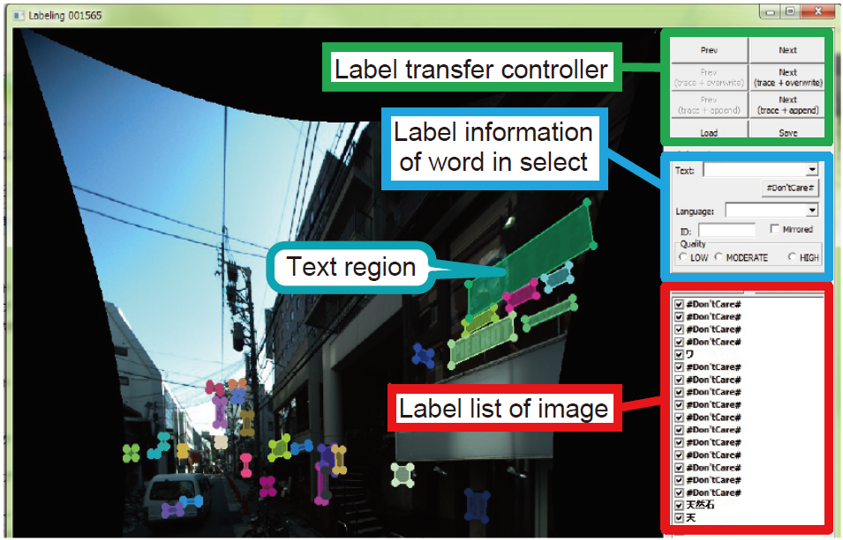
Construction of
DOST Dataset
We spent more than 1,500 man hours
Manual ground truthing
  Most of GT policies are shared with ICDAR2013 & 2015 Challenge 3 datasets
  GT software was developed
    Reuse GT information
    in neighboring frames
Privacy
preservation
  Faces were blurred

Slide 22
Ground Truthing Policy
Basic unit
  Word or Bunsetsu (in Japanese)
  Proper noun is not divided
Bounding box
  Basic unit is represented by its four corners
Bunsetsu: the smallest unit of words that sounds natural in a spoken sentence

Slide 23
Ground Truthing Policy
Transcription
  transcription consists of visible characters
Quality
  High, mid or low
  Low corresponds to “Don’t care” regions
ID
  The same ID is assigned to a sequence of same basic units as long as it can be traced
  Trace ends when a basic unit completely goes out from the frame

Slide 24
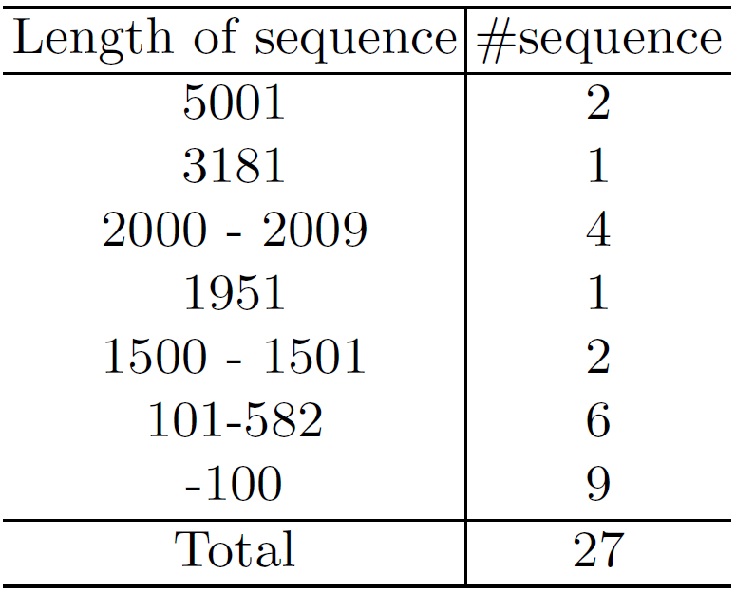
Distribution of lengths of image sequences

Slide 25
Agenda
Introduction
Unique Features of DOST Dataset
Construction of DOST Dataset
Known Issues
Evaluation
Conclusion

Slide 26

Known Issues
We will improve them
Ground truths are not perfect
  Bounding boxes of text regions
  are not tight enough
  Ground trothing “Don’t care”
  is not comprehensive
  Some word sequences are broken
Relationship between other cameras
  Word images in other cameras are not followed
“Don’t care” is marked in illegible regions

Slide 27
Agenda
Introduction
Unique Features of DOST Dataset
Construction of DOST Dataset
Known Issues
Evaluation
Conclusion

Slide 28
Evaluation: Methods
Text detection
  OpenCV API
  Matsuda’s method based on NAT method
End-to-end text recognition
  Google Vision API

Slide 29
Evaluation: Datasets
Image datasets
  ICDAR2003
  ICDAR2013 Chal. 2
  ICDAR2015 Chal. 4
  SVT
  COCO-Text
Video datasets
  ICDAR2015 Chal. 3
  YVT
  DOST
  DOST Latin
Subset of DOST which contain words consisting of alphabets and digits
Data were sampled

Slide 30
Text Detection by
OpenCV API
Image DB
Video DB

Slide 31
Text Detection by Matsuda's method
Image DB
Video DB

Slide 32
End-to-end Text Recognition by
Google Vision API
Image DB
Video DB
Recognized in Japanese mode

Slide 33
Agenda
Introduction
Unique Features of DOST Dataset
Construction of DOST Dataset
Known Issues
Evaluation
Conclusion

Slide 34
Conclusion
DOST dataset is presented
  Has unique features
  More challenging than existing datasets

Slide 35
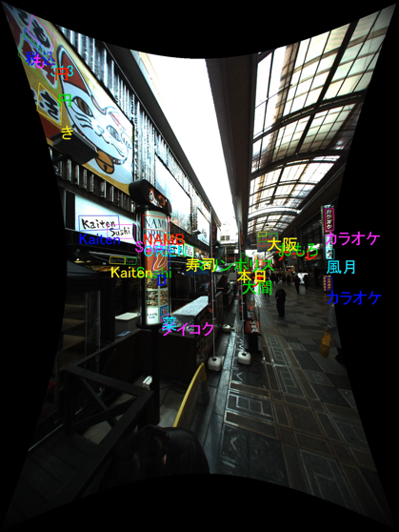
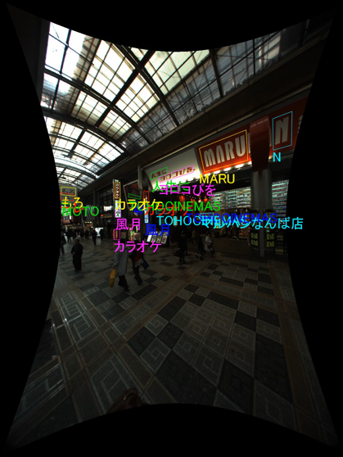
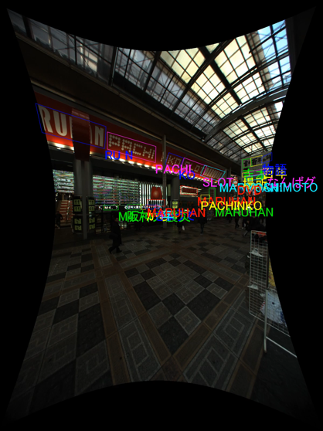
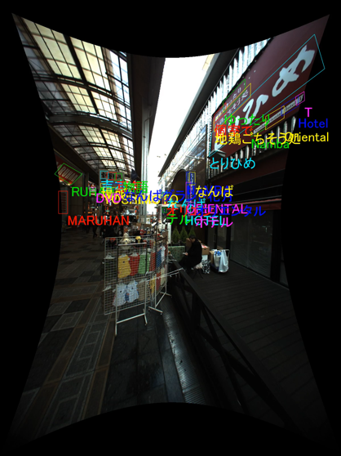
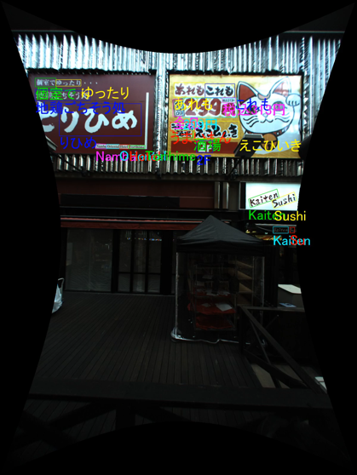
Thank you for your attention!!

