Slide 1
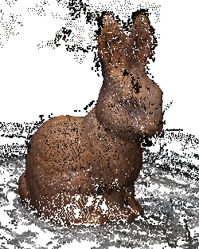
Denser Feature Correspondences for 3D Reconstruction
Fairuz Safwan Mahad
Masakazu Iwamura
Yuzuko Utsumi
Koichi Kise
Graduate School of Engineering
Osaka Prefecture University

Slide 2
Outline
1. Background Study
2. Proposed Method
3. Experiments
4. Conclusion

Slide 3
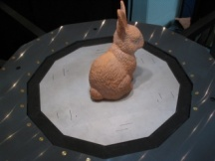
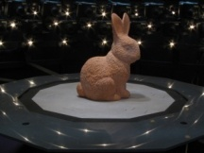
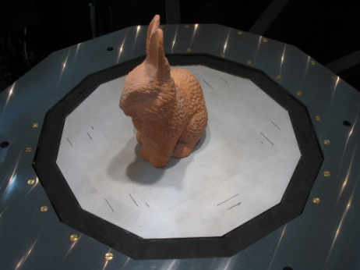
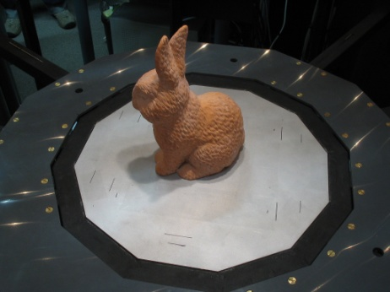
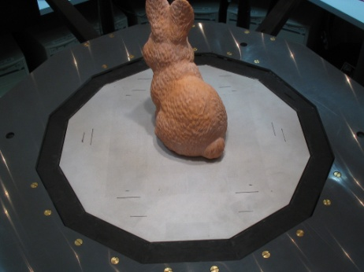
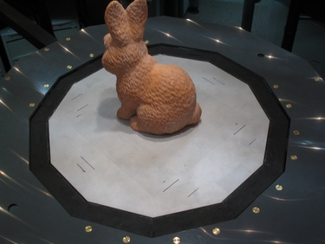
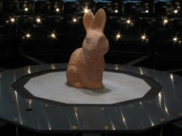
Background Study WHAT is 3D reconstruction?
Reconstructs a 3D representation with a set of images from different viewpoints
Set of images
Reconstructed 3D Model

Slide 4
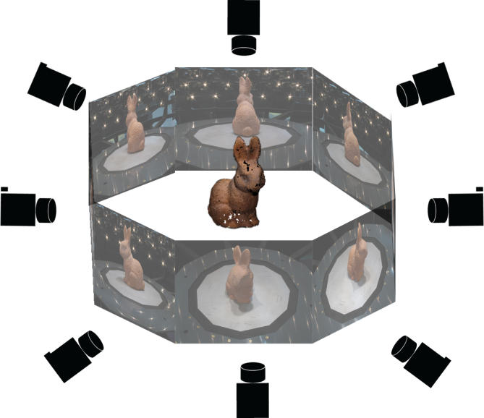
Background Study Standard Approach
Object with
rich texture
Camera Location Estimation
Dense point
cloud generator
(Bundler)
(PMVS2)
Reconstructed
3D Model
Set of images

Slide 5
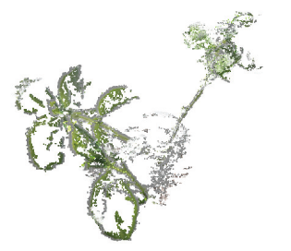
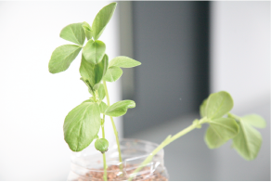
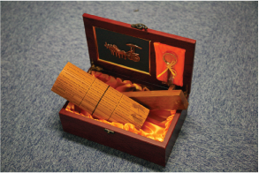
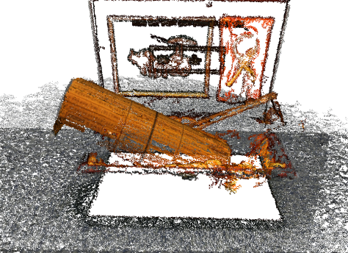
Background Study Failed 3D Reconstruction
Objects with lack of texture
Original Image
3D Model
1
Plant
Caused by lack of feature correspondences
3D models have many gaps/holes
3D models have many gaps/holes
2
Wooden Box

Slide 6
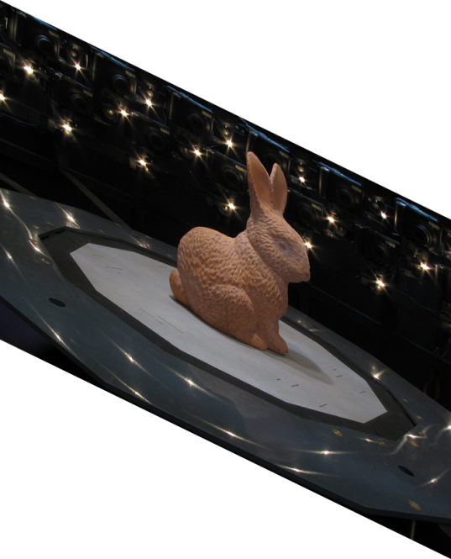
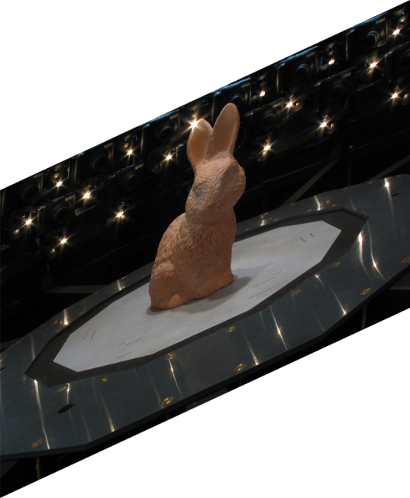
Background Study Feature Correspondences
Features
Corresponding Features

Slide 7
Background Study 2 problems caused by Lack of Feature correspondences
Our research focus
Inaccurate camera
estimation
2. Lack of patches
Camera Location Estimation
Dense point
cloud generator
(Bundler)
(PMVS2)
Reconstructed
3D Model
Set of images

Slide 8
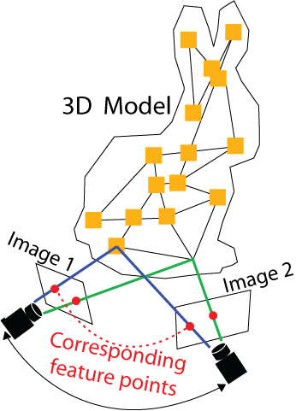
Background Study Importance of Correspondences
Patch
Features
Line of sight
3D reconstruction requires good correspondences between images

Slide 9
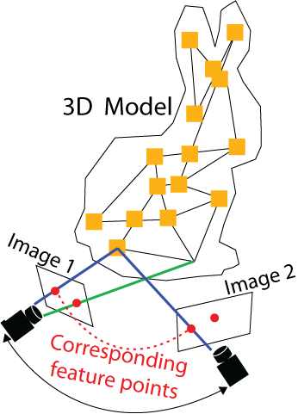
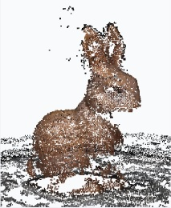
Background Study Importance of Correspondences
Patch
Features
Line of sight
No Patch
3D reconstruction requires good correspondences between images
If there are no correspondences, there will be holes in the reconstructed 3D representation

Slide 10
Background Study Comparing Methods
OUR TARGET
Methods | Textured regions | Less-textured regions
Standard Approach (SIFT & Harris)

Slide 11
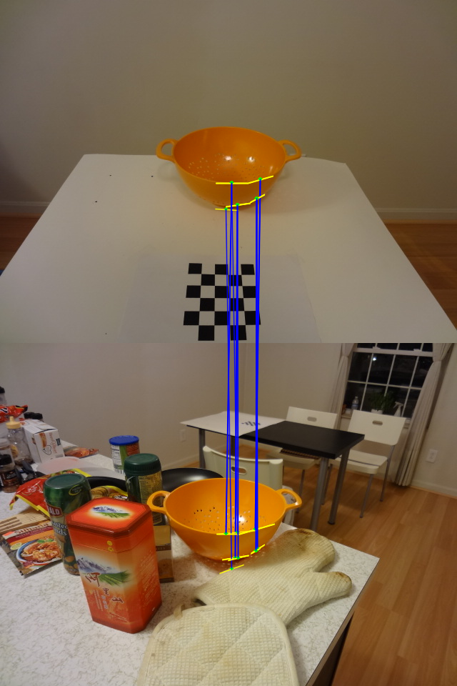
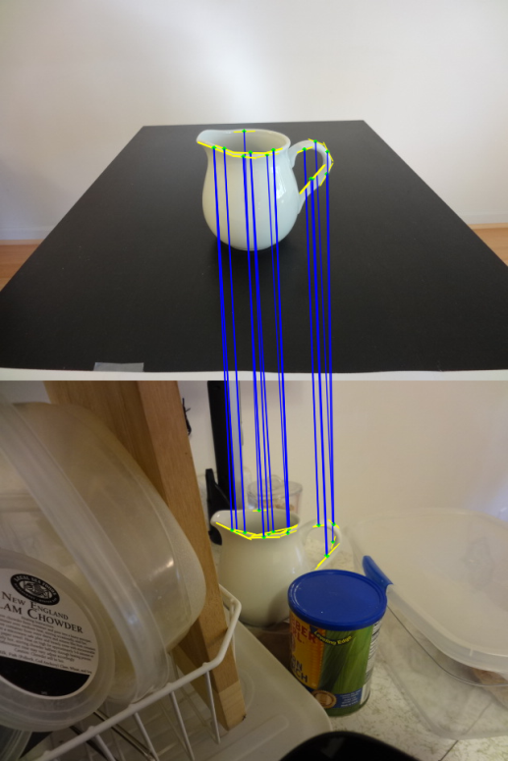
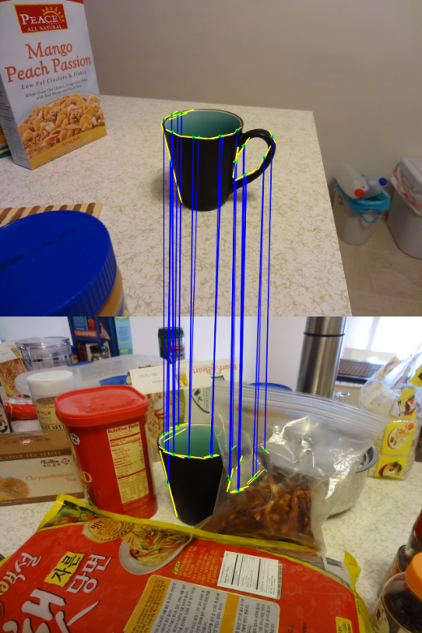
Background Study Bunch of Lines Descriptors (BOLD) [Tombari et al., 2013]
BOLD
uses edges to detect texture-less objects
descriptor for line segments

Slide 12
Background Study Comparing Methods
OUR TARGET
Methods | Textured regions | Less-textured regions
Standard Approach (SIFT & Harris)
Standard Approach (BOLD)
Problems:
1. Recognizes artificial objects but not natural objects such as plants
2. Does not work well with rounded objects or simple-shaped objects

Slide 13
Background Study Proposed Method
Proposed Method : Obtain more correspondences between images with additional features
Patch
Features
Additional feature
Patch obtained
Patch obtained
Line of sight
The proposed method uses:
1. Convolution
2. Randomized kernels

Slide 14
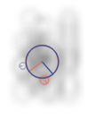
Background Study Proposed Method
1. Reason for using convolution
Coded Aperture:
Original
Image
Coded
aperture
Convoluted
Image
Images:
*
=
Features extracted:
Capable of changing the structure of the image
Additional features can be obtained from convoluted images [Iwamura et al., Recognition of Defocused Patterns, CVA, 2014]

Slide 15
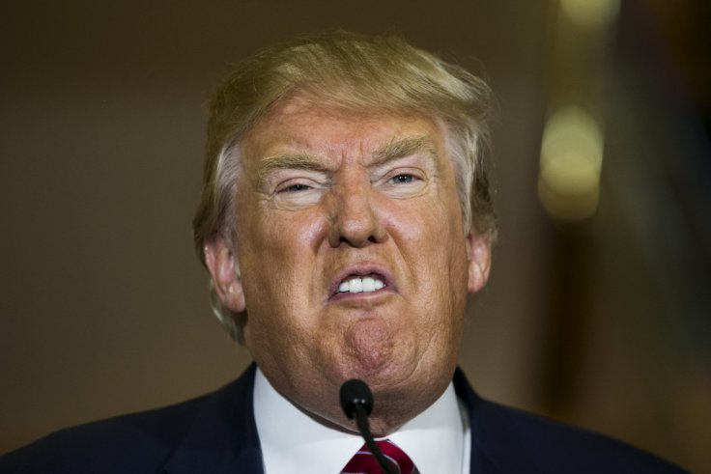
Background Study Proposed Method
2. Reason for using randomized kernels
Original
Image
Coded
aperture
Convoluted
Image
*
=
Cannot guarantee it is optimized for all other images
Assuming this is the optimum for 8
Is this still optimum?
*

Slide 16
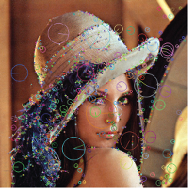
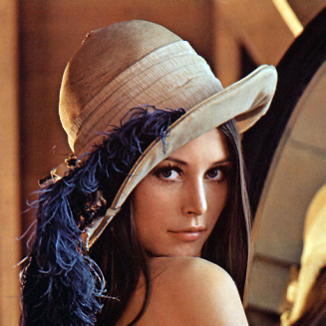
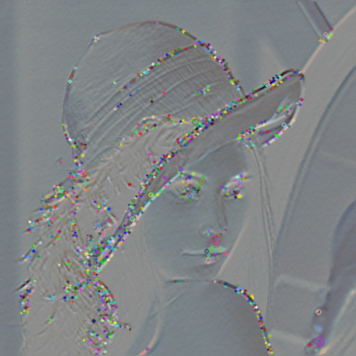
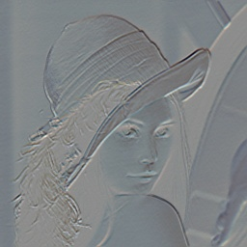
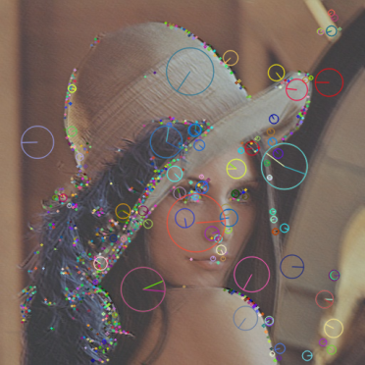
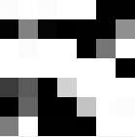
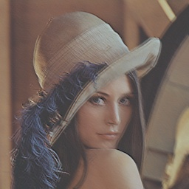
Background Study Proposed Method
2. Reasons for using randomized kernels (cont.)
Images are convoluted with different randomized kernels
*
=
*
=
Original
Image
Random
Kernels
Convoluted
Images
SIFT Features

Slide 17
Background Study Comparing Methods
OUR TARGET
Methods | Textured regions | Less-textured regions
Standard Approach (SIFT & Harris)
Standard Approach (BOLD) | (Limited to specific shapes) | (Limited to specific shapes)
Proposed Method (Randomized kernel convolution)

Slide 18
Outline
1. Background Study
2. Proposed Method
3. Experiments
4. Conclusion

Slide 19
Proposed Method Overview
Camera Location Estimation
Dense point
cloud generator
(Bundler)
(PMVS2)
Reconstructed
3D Model
Our research focus
Set of images
Bundler Component
PMVS2 Component
Camera Location Estimation
Dense point
cloud generator
(Bundler)
(PMVS2)
Reconstructed
3D Model
Set of images

Slide 20
Proposed Method Overview
Set of images
PMVS2
Reconstructed
3D Model
Convolution
m

Slide 21
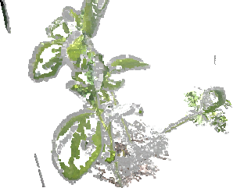
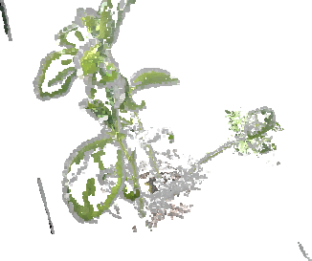
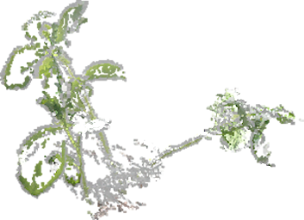
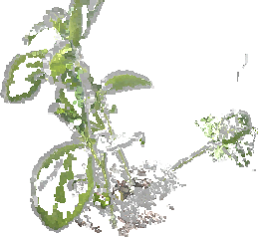
Reconstructed region to focus
Proposed Method
Effect of m
Artefacts
m = 1
m = 0
m = 10
m = 100
m should be sufficiently large
m
0
1
10
100

Slide 22
Proposed Method Overview
Set of images
PMVS2
Convolution
Reconstructed
3D Model 1
Concatenate
m
Set of images
PMVS2
Concatenate
n
Convolution
Reconstructed
3D Model 2
Final
3D Model
m
Concatenate
Set of images
PMVS2
Convolution
Reconstructed
3D Model 3
m

Slide 23
Outline
1. Background Study
2. Conventional Method
3. Proposed Method
4. Experiments
5. Conclusion

Slide 24
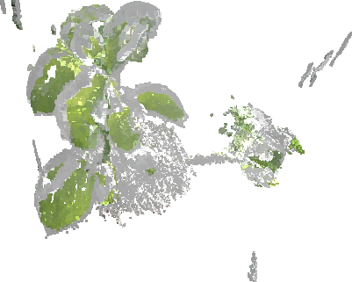
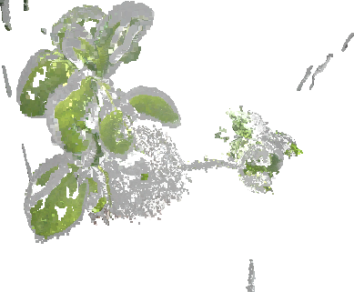
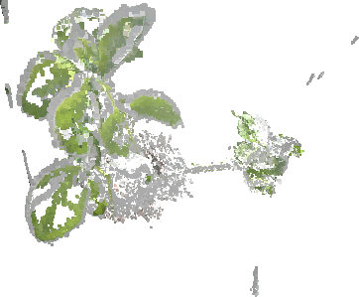
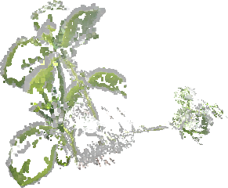
Experiments
Relationship between m and n
n
n=500 m=1
500
n=50 m=10
50
n=5 m=100
n=0 m=0
5
m
0
1
10
100

Slide 25
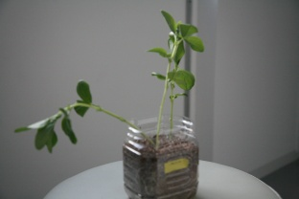
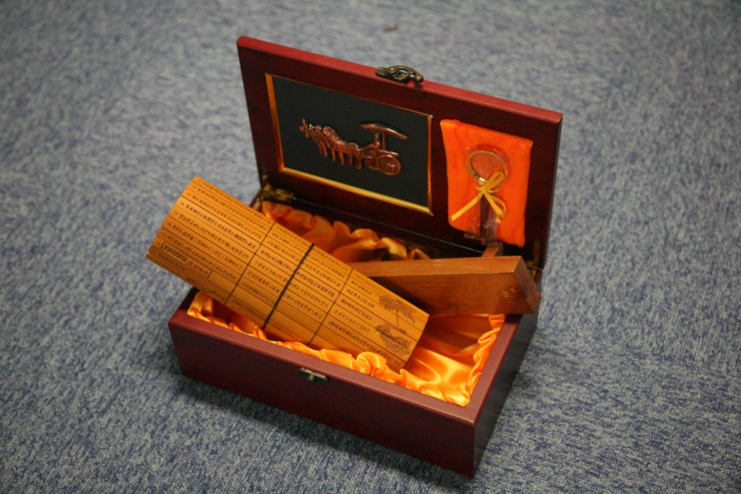
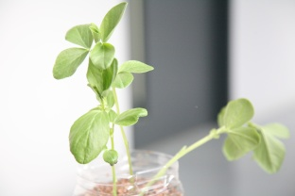
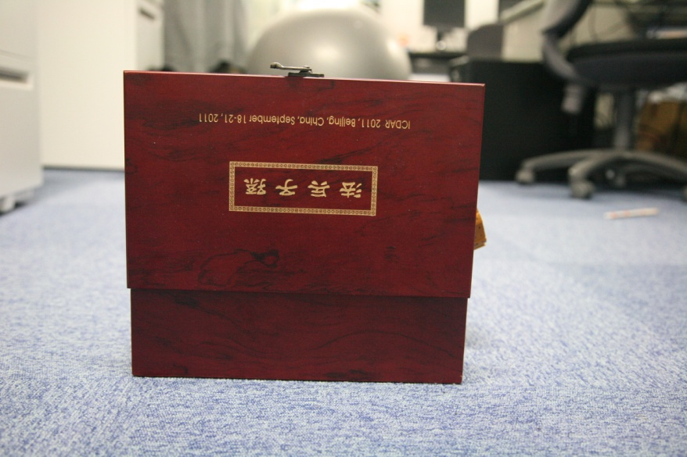
Experiments
Summary
Dataset | Plant | Wooden Box
e.g. of images
No. of Images | 27 | 21
No. of randomized kernels | 500 | 500
Kernel Size | 7x7 | 7x7

Slide 26
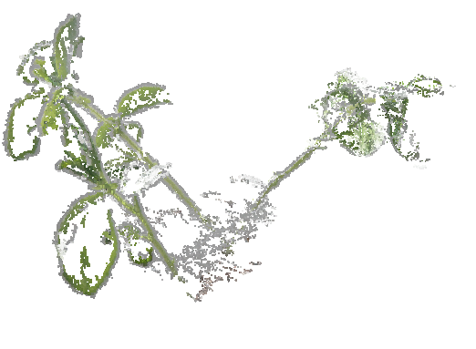
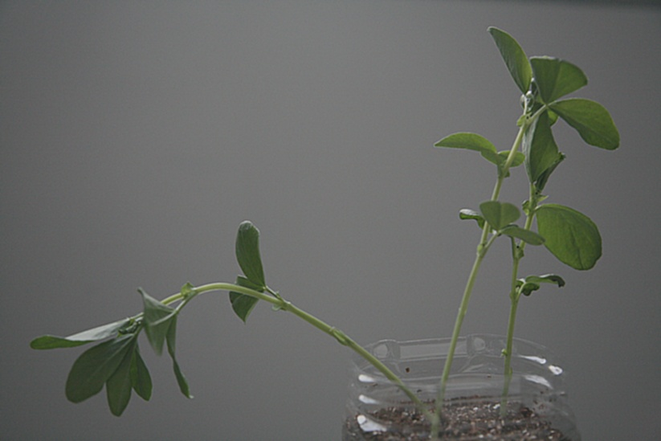
Experiments
Plant
Conventional 3D Model

Slide 27
Experiments

Slide 28
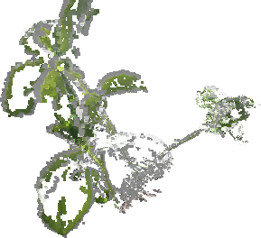
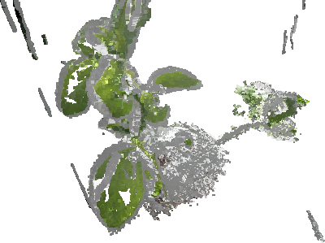
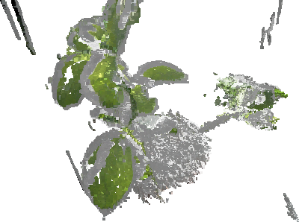
Experiments
Plant
Conventional Method
n=50 m=10
Proposed Method
n=500 m=1

Slide 29
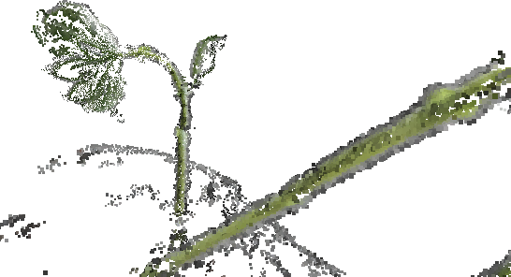
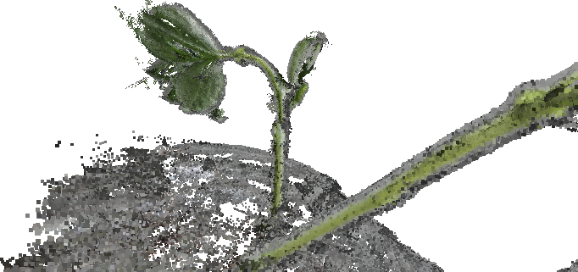
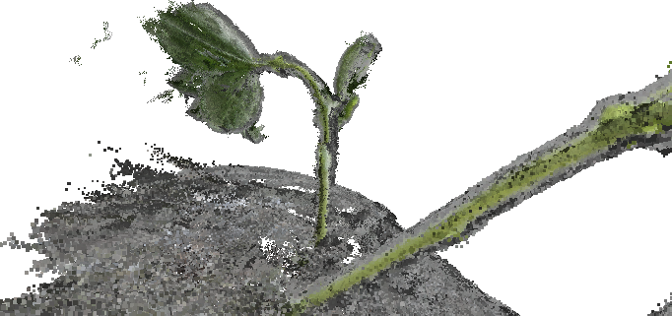
Experiments
Plant
n=50 m=10
Proposed Method
Conventional Method
n=500 m=1

Slide 30
Experiments
Wooden Box
Conventional 3D Model

Slide 31
Experiments
Wooden Box
Conventional Method
Proposed Method

Slide 32
Experiments
Wooden Box
Conventional Method
Proposed Method

Slide 33
Experiments
Wooden Box
Conventional Method
Proposed Method

Slide 34
Outline
1. Background Study
2. Conventional Method
3. Proposed Method
4. Experiments
5. Conclusion

Slide 35
Conclusion
many gaps in the 3D
Reconstructed model
PROBLEM
DUE TO
Lack of correspondences
SIFT & Harris being incapable of
extracting features from less
textured regions
CAUSED BY
Convoluting images with randomized
kernels to increase the complexity of
Images
IMPROVED BY

Slide 36
Thank you for your attention!
Title: Denser Feature Correspondences for 3D Reconstruction

Slide 37
Conventional Method Overview
Relative Estimated Camera location
Bundler
PMVS2
Reconstructed
3D Model
Set of images
Bundler Component
PMVS2 Component
PMVS2
Bundler
Set of images
Reconstructed
3D Model
Set of images

Slide 38
Background Study Randomized kernel
The value of each cell is…
………
Normalization

Slide 39
Background Study Proposed Method
2. Reason for using randomized kernels
Creating a coded aperture for the sole purpose of extracting more features is not easy.
Randomized kernels allow images to be convoluted in many different ways.
Original
Image
Coded
aperture
Convoluted
Image
*
=
=
*

Slide 40
Experiments
Plant
Conventional Method
Proposed Method

Slide 41
Experiments
Conventional Method
Proposed Method

Slide 42
Proposed Method Overview
Set of images
Relative Estimated Camera location
PMVS2
Reconstructed
3D Model
Convolution
m

Slide 43
Background Study Lowe : Scale-Invariant Feature Transform (SIFT) & Harris
SIFT
One of the ways to get correspondences between images is to use SIFT
SIFT is a method which
extracts unique keypoints
or features from images to
be used for matching
purposes
Harris
Corner detector
Example of SIFT features extracted
Problem: Cannot extract features from regions with lack of texture.

Slide 44
.
.
.
.
.
.
Proposed Method Convolution
Convoluted
image set 1
Convoluted
image set 2
Convoluted
image set m
Original image set
+
…
…
…
m
n
iterations
Convoluted
image set 1
Convoluted
image set 2
Convoluted
image set m
Original image set
+
…

Slide 45
Conventional Method Overview

Slide 46
Background Study WHY is it needed? (Motivation)
Successful 3D Reconstruction
Failed 3D Reconstruction
Objects with rich in texture
Objects with lack of texture
Original Image
3D Model
Original Image
3D Model
1
Roman Soldier
1
Plant
2
Stanford Bunny
2
Wooden Box
3D models are almost complete
3D models have many gaps/holes

Slide 47
Background Study Objective of Research
The 3D reconstructed representation have many missing parts or holes which can be further improved
The research focuses on
reducing the holes
Getting a much more complete reconstructed 3D representation of an object
Research Objective : Obtain more correspondences between images with additional features.
.
.
.
Reconstructed
3D Model
Areas to improve
(Red region)
Ideal final
Reconstructed
3D Model
Input images

Slide 48
Experiments
Conventional Method
Proposed Method

Slide 49
Experiments
Conventional Method
Proposed Method

Slide 50
Experiments
Conventional Method
Proposed Method

Slide 51
Proposed Method Convolution
Input image sets are convoluted with n random kernels
Correspondences of all convoluted and original (unconvoluted) sets are combined
Kernels are generated randomly with values ranging from -1 to 1
*
= Convoluted image set 1
Input Image set
Kernel 1
*
= Convoluted image set 2
Input Image set
Kernel 2
.
.
.
.
.
.
*
= Convoluted image set n
Input Image set
Kernel n

Slide 52
Background Study Proposed Method
1. Convolution
Capable of making an image much more complex
A complex image allows more features to be extracted

Slide 53
Conventional Method Overview
Features &
Correspondences
3D Reconstruction
SIFT
Set of images with
different perspective
3D reconstructed
representation

Slide 54
Proposed Method Overview
Set of images with
different perspective
Proposed Method
Convolution
Convoluted
Images
*
Kernel 1
.
Kernel 2
*
.
.
.
*
Kernel n
SIFT
Original Images (unconvoluted images)
Conventional Method
More
Features &
Correspon-
dences
3D Reconstruction
3D reconstructed
representation

Slide 55
Proposed Method Overview
Set of images with
different perspective
Proposed Method
Convolution
Convoluted
Images
*
Kernel 1
.
Kernel 2
*
.
.
.
*
Kernel n
SIFT
Original Images
More
Features &
Correspon-
dences
3D Reconstruction
3D reconstructed representation

Slide 56
Background Study Objective of Research
The 3D reconstructed representation have many missing parts or holes which can be further improved.
The research focuses on
reducing the holes
Getting a much more complete reconstructed 3D representation of an object.
3D Model
2D Image
Camera

Slide 57
Conventional Method Multi-View Stereo
The goal of Multi-view stereo is to reconstruct a 3D representation.
The Multi-View Stereo requires Camera parameters as input in order to reconstruct a 3D representation.
Features &
Correspondences
SfM
(Bundler)
SIFT
Multi-view Stereo (PMVS2)
Camera
Parameters
Set of images with
different perspective
3D reconstructed
representation

Slide 58
Conventional Method Structure from Motion (SfM)
Structure from Motion (SfM)
estimates 3D structures from 2D structures.
Computes 3D points from corresponding points.
http://michot.julien.free.fr/drupal/?q=content/research

Slide 59
Experiments
Conventional Method
Proposed Method

Slide 60
Proposed Method Convolution
There is a relationship between the size of the kernels and the number of extracted features.
The smaller the size of the kernel, the more features are extracted.
Resized
Resized
20x20 pixels
14x14 pixels
7x7 pixels

Slide 61
Proposed Method Convolution
No. of Features extracted

Slide 62
Proposed Method Convolution
Kernels are generated randomly with values ranging from -1 to 1
Convolution is performed for n iterations.
Correspondences of all convoluted and original (unconvoluted) sets are combined.
*
= Convoluted image set 1
Input Image 1
Kernel 1
*
= Convoluted image set 2
Input Image 2
Kernel 2
.
.
.
.
.
.
*
= Convoluted image set n
Input Image n
Kernel n

Slide 63
Proposed Method Overview
Set of images with
different perspective
Proposed Method
Convolution
Convoluted
Images
*
Kernel 1
.
Kernel 2
*
.
.
.
*
Kernel n
SIFT
Original Images
More
Features &
Correspon
dences
Multi-view Stereo (PMVS2)
SfM (Bundler)
Camera
Parameters
3D reconstructed representation

Slide 64
Conclusion
1. Conventional Method: many gaps in the 3D reconstructed representation.
2. Caused by lack of correspondences
Proposed Method: addresses this issue by proposing the implementation of convolution on query images in order to increase its complexity.
A set of randomized kernels are used to convolve images.
The proposed method is capable of patching up missing parts which could not be realized conventionally.

Slide 65
Convolution
Coded Aperture/Kernel
20x20 pixels
DIGITAL
Camera
INPUT
Image
OUTPUT
Processor
Optical
Image
System
Sensor
Convoluted Image
Original
Image
Convolution makes the
Images much more complex
Once images are made complex,
features can be increased.

Slide 66
Background Study Bundler
Bundler is a structure-from-motion(SfM) system which requires several inputs such as
Set of images
Image features extracted by SIFT
Image matches
Set of images with
different perspective
Example of matches
SIFT
Features &
Matches
Bundler
OUTPUT : Camera Parameters

Slide 67
Background Study PMVS2
PMVS2 is a software which takes in the camera parameters outputted by Bundler.
Based on the camera parameters, PMVS2 will create a final 3D reconstructed image.
Camera
Parameters
Bundler
PMVS2
3D reconstructed image

Slide 68
Scale-Invariant Feature Transform(SIFT)
Gaussian filter will be
applied on an image
iteratively.
After the first octave,
the image will be
resample and the
second octave is
processed
Gaussian
filter
X
=

Slide 69
Scale-Invariant Feature Transform(SIFT)
The Difference of Gaussian(DOG) can be obtained by
subtracting the Gaussian images.
Example of DoG

Slide 70
Scale-Invariant Feature Transform(SIFT)
Finding local extrema
A pixel(X) in an image will be compared with its 26 neighbours
in the previous and next scale.
If the value is the lowest or highest among them, it is selected as a keypoint.

Slide 71
Proposed Method Overview
Problem
Solution
Conventional
3D reconstructed images
have missing parts
- Due to correspondences
i. Implements Convolution
in order to acquire more
features.
ii. More features means
the 3D reconstructed
images will be much
more complete.
Proposed
Method
With more
Features extracted
3D reconstructed image

Slide 72
Experiments
Matching Results
Original
Image
Convoluted
Image

Slide 73
Experiments
Convoluted image obtained a higher number of matches as compared to the original image without convolution

