Slide 1



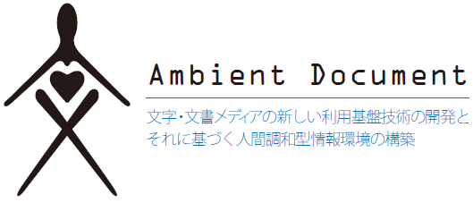

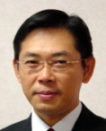
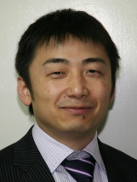


Automatic Ground Truth Generation of Camera Captured Documents Using Document Image Retrieval
Sheraz Ahmed, Koichi Kise, Masakazu Iwamura, Marcus Liwicki, and Andreas Dengel

Slide 2
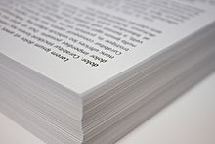
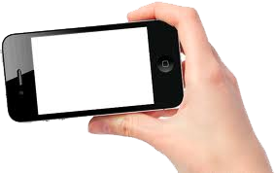
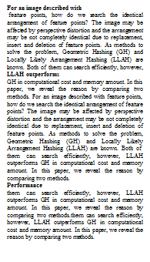
Problem to be tackled
OCR for camera-captured documents
☺ Convenient
☺ Useful
☹ Poor OCR performance
OCR results

Slide 3





OCR response for camera-captured words
Suffer from blur, perspective distortion, illumination change and so on
Camera-captured words | Ground Truth | Tesseract | GOCR | OCRopus
 | otherwise | utharvdlu | l | ee=e
 | recognises | T,- |  | ee=
 | Legislative | \ | LR iild1K | 4A
 | Percent | pauznx | _______ | e=
 | construction | ummuciw | wns ion | e=w==s

Slide 4
Quantity improves quality
A large quantity of data improves quality of recognition
Large-scale datasets are demanded
Recognition rate
Dataset size
Dataset
Dataset
Wider variety of fonts and distortions

Slide 5

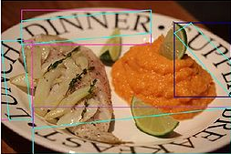

Existing datasets on camera-captured text
Different tendencies from text in document images
Document
Scene
IUPR Dataset
  Word-level groundtruth is unavailable
  100 pages
Street View House Numbers
  630,000 numerals
NEOCR
  5,238 words
Chars74k
  74,107 characters
Only numerals
Too small
Not usable for OCR training
Limitation to use existing datasets

Slide 6
Purpose
To develop a method to easily create a large dataset
Dataset
Successfully groundtruthed one million word images with 99.98% accuracy!

Slide 7
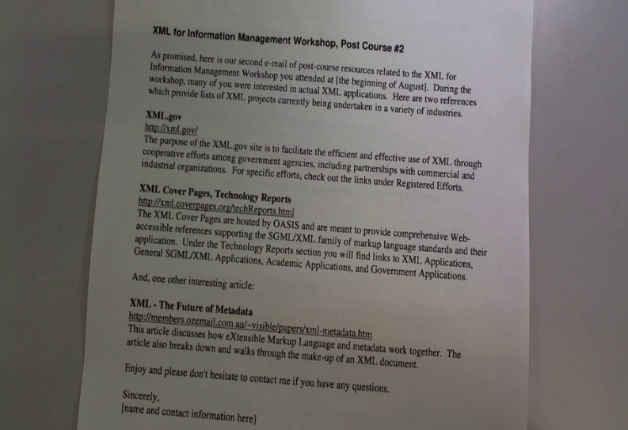

A way to create a dataset
This is “National”
Cropped word image
Captured image
Groundtruthing
Problematic

Slide 8
Groundtruthing is problematic
GOAL
Manual groundtruthing is laborious and costly
Automatic groundtruthing is not reliable
Reliable automatic groundtruthing

Slide 9

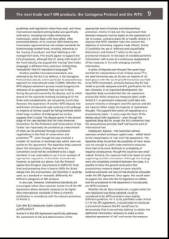
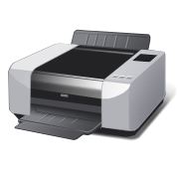

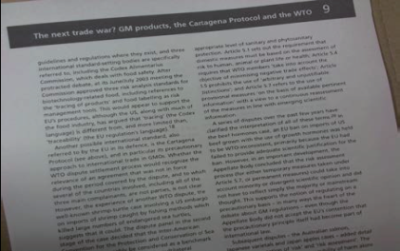
Idea
Use text information embedded in PDF files
Text info.
Groundtruthing
Print
Capture
PDF file
Printed document
Captured document image

Slide 10
Idea
Use text information embedded in PDF files
Text info.
Groundtruthing
Print
Capture
PDF file
Printed document
Captured document image

Slide 11
Idea
Use text information embedded in PDF files
How do we fit the text information into the captured document image?
Text info.
Groundtruthing
Print
Capture
PDF file
Printed document
Captured document image

Slide 12
Fitting text information into captured document image
For scanned document image
  Similarity transformation [Beusekom, DAS2008]
For camera-captured document image
  Perspective transformation
  Affine transformation (approximately)
Not applicable to camera-captured case
No method exists

Slide 13
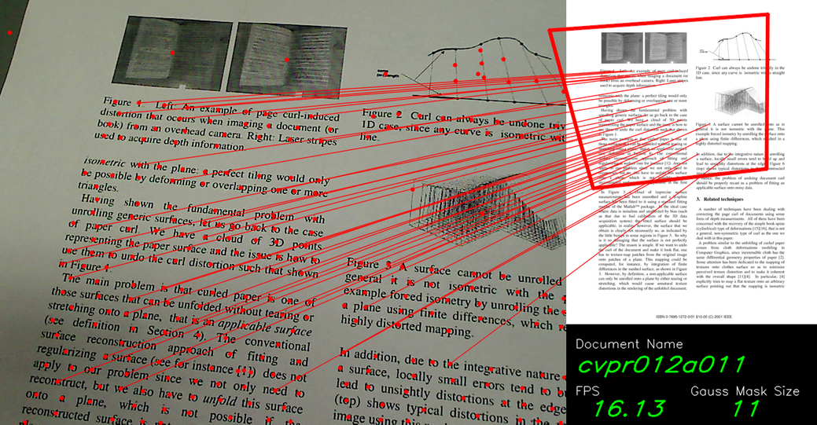
Locally Likely Arrangement Hashing (LLAH)
DB: 20M pages
Time：49ms/query
Accuracy： 99.2%
Find the region corresponding to the captured one from 20M pages in real time
Captured image (Query)
Search result
Corresponding region
Corresponding page
Pose is estimated simulateneously

Slide 14
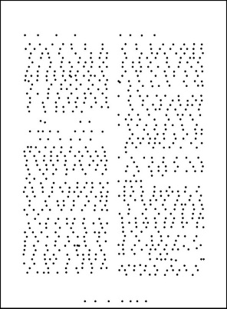
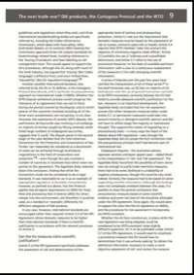

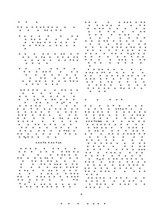
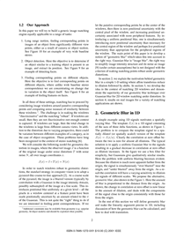
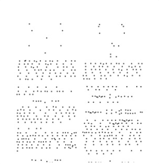
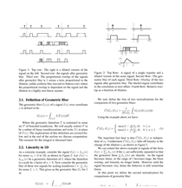
Proposed procedure (1):
Document level matching
Based on LLAH
Digital doc. images
Features
DB
Captured image (Query)

Slide 15
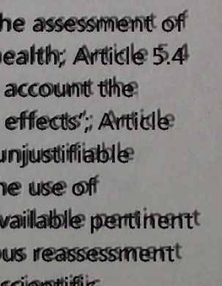
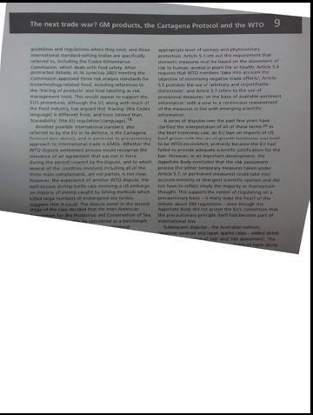

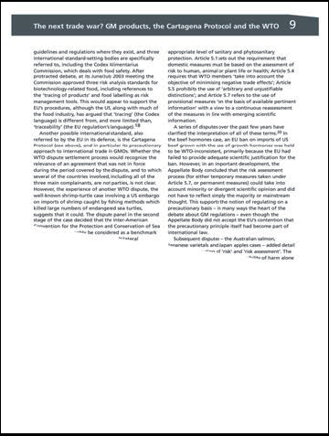

Proposed procedure (2):
Part level processing
Transformed captured image
Cropped retrieved image
Overlapped image
This is not the end of the proceedure
Displacement of text

Slide 16
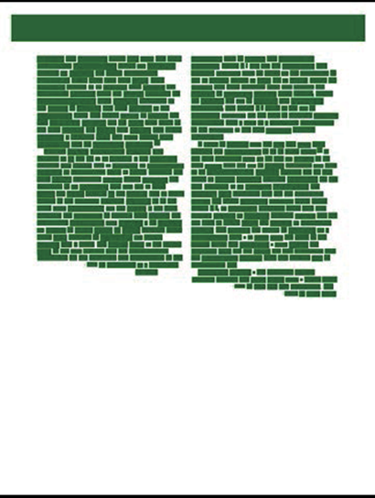
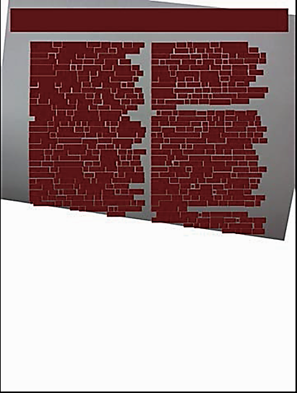
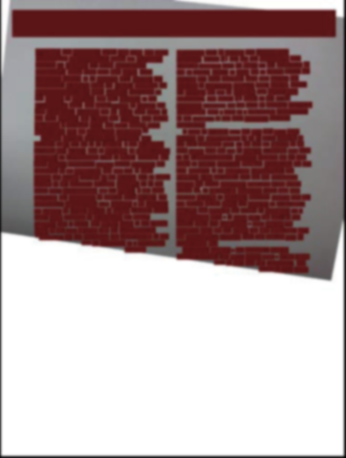
Proposed procedure (3):
Word level processing
Cropped Retrieved Image
Overlapped Bounding Boxes
Transformed Captured Image
Find the closest bounding boxes and select perfectly aligned ones only

Slide 17
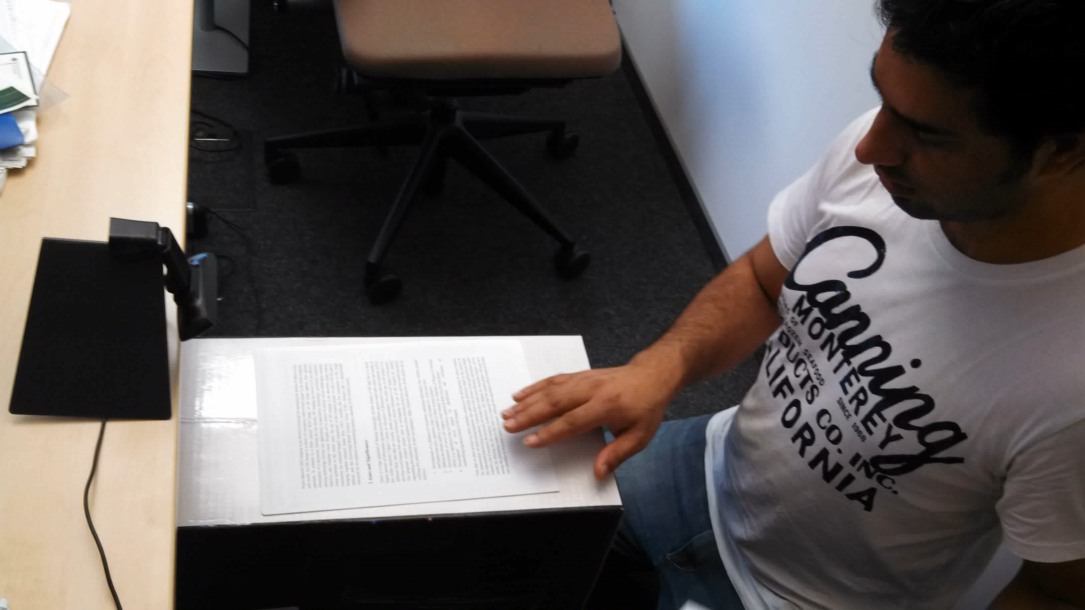
Dataset creation
Document images were captured

Slide 18
Dataset creation
Document images were captured
  With a few different cameras
  Documents include proceedings, books, magazines and articles
Word and character image were automatically groundtruthed

Slide 19















































Obtained degraded word images
Obtained character images

Slide 20
Evaluation
50,000 word images were randomly selected from one million images
  Manual counting revealed that the accuracy was 99.98%
  The errors were caused by mainly wrong alignment of bounding boxes

Slide 21
Contribution
A fully automatic groundtruthing method for word and character images in camera-captured documents is proposed
  One million word images were groundtruthed
  Accuracy: 99.98%
Amazingly high for a fully automated method

Slide 22
Automatic Ground Truth Generation of Camera Captured Documents Using Document Image Retrieval
Sheraz Ahmed, Koichi Kise, Masakazu Iwamura, Marcus Liwicki, and Andreas Dengel

Slide 24


Workaround of groundtruthing
Synthetic approach with degradation models [Ishida, ICDAR2005] [Tsuji, KJPR2008]
Degradation
Questionable to say this represents real degradation

Slide 25

Words at border
Partially missing

Slide 26












Words at border
Can increase confusion between characters:
Marked with special flag

